Slide 1
CSS Review
Week 2 Session 2

Slide 2
Contents of This Session
Review of CSS

Slide 3
CSS
Stands for Cascading Style Sheets
Describes the appearance and layout of information on a webpage

Slide 4
Benefits of CSS
Separate style (presentation) from content (meaning)
Less code is needed – faster downloads
Makes it faster and easier to change the appearance of your websites
Easy to learn syntax
Easy to author using Dreamweaver or other HTML editing software.

Slide 5
Three Ways to Insert CSS
type="text/css"
There are three ways of inserting a style sheet:
External style sheet
<head> <link rel="stylesheet" type="text/css" href="mystyle.css”> </head>
Internal style sheet
<head> <style type="text/css"> body { background-color: linen;} </style> </head>
Inline style
<h1 style="color:blue;margin-left:30px;">This is a heading.</h1>

Slide 6
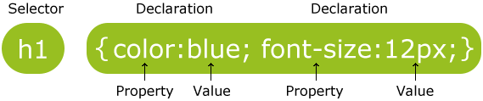
CSS Syntax
CSS rule has two main parts:
A selector (id, class, HTML element)
One or more declarations - each declaration consists of a property and a value
Example:

Slide 7
CSS Syntax
The id selector is used to specify a style for a single, unique element and is defined with a “#”
The class selector is used to specify a style for a group of elements and is defined with a "."
Example:
#para1 { text-align:center; color:red; }

Slide 8
CSS Background
CSS background properties are used to define the background effects of an element.
CSS properties used for background effects:
background-color
background-image
background-repeat
background-attachment
background-position

Slide 9
CSS Text
Css Text Properties allow to format texts contained inside the elements
CSS properties used for formatting texts:
color
text-align
text-decoration
text-transform
text-indent

Slide 10
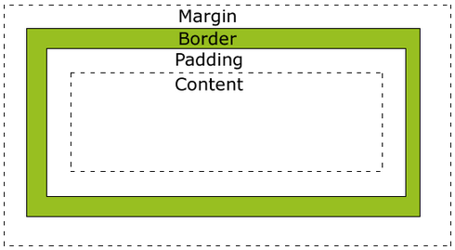
CSS Box Model
Every element is composed of
Content - The content of the box, where text and images appear
Padding - Clears an area around the content. The padding is transparent
Border - A border that goes around the padding and content
Margin - Clears an area outside the border. The margin is transparent

Slide 11
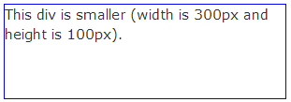
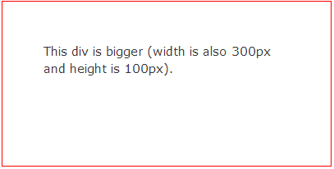
CSS Box Model
By default, the width and height of an element is calculated like this:
width + padding + border = actual width of an element
height + padding + border = actual height of an element
.div1 {
width: 300px;
height: 100px;
border: 1px solid blue;
}
.div2 {
width: 300px;
height: 100px;
padding: 50px;
border: 1px solid red;
}
100 px longer for both width & height

Slide 12
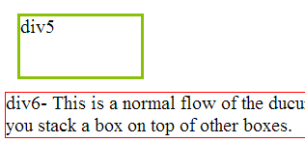
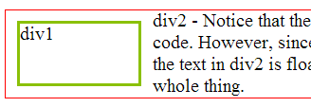
CSS Float
The float property specifies whether or not an element should float.
Without Float
With Float
.div1 {
float: left;
width: 100px;
height: 50px;
margin: 10px;
border: 3px solid #8AC007;
}
.div2 { border: 1px solid red;}
.div5 {
width: 100px;
height: 50px;
margin: 10px;
border: 3px solid #8AC007;
}
.div6 { border: 1px solid red;}

Slide 13
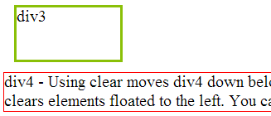
CSS Float
The clear property specifies whether or not an element should float.
Without Clear
With Clear
.div1 { float: left;
width: 100px;
height: 50px;
margin: 10px;
border: 3px solid #8AC007;
}
.div2 { border: 1px solid red;}
.div3 { float: left;
width: 100px;
height: 50px;
margin: 10px;
border: 3px solid #8AC007;
}
.div4 { border: 1px solid red;
clear: left; }

Slide 14
CSS Position
The position property specifies the type of positioning method used for an element. There are four different position values:
Static ← default behavior
relative
fixed
absolute
Elements are then positioned using the top, bottom, left, and right properties.

Slide 15
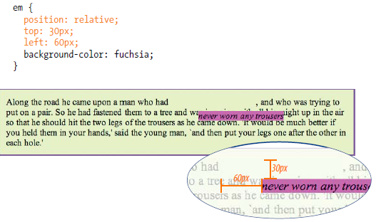
CSS Position
An element with position: relative; is positioned relative to its normal position.
Example of relative positioning

Slide 16
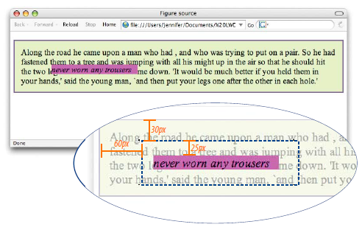
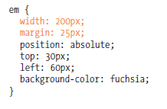
CSS Position
An element with position: absolute; is positioned relative to its nearest containing element
Example of absolute positioning

Slide 17
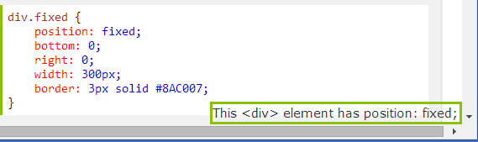
CSS Position
An element with position: fixed; is positioned relative to the viewport(a.k.a your Pc monitor)
it always stays in the same place even if the page is scrolled.
Example of fixed positioning

Slide 18
Exercise
CSS Exercise
CSS Page Layout Exercise

Slide 19
End of The Session 2
Week 2

